Slide 1
Exploratory Data Analysis
Statistics 2126

Slide 2
Introduction
If you are going to find out anything about a data set you must first understand the data
Basically getting a feel for you numbers
  Easier to find mistakes
  Easier to guess what actually happened
  Easier to find odd values

Slide 3
Introduction
One of the most important and overlooked part of statistics is Exploratory Data Analysis or EDA
Developed by John Tukey
Allows you to generate hypotheses as well as get a feel for you data
Get an idea of how the experiment went without losing any richness in the data

Slide 4
Hey look, numbers!
x (the value) | f (frequency)
10 | 1
23 | 2
25 | 5
30 | 2
33 | 1
35 | 1

Slide 5
Frequency tables make stuff easy
10(1)+23(2)+25(5)+30(2)+33(1)+35(10
= 309

Slide 6
Relative Frequency Histogram
You can use this to make a relative frequency histogram
Lose no richness in the data
Easy to reconstruct data set
Allows you to spot oddities

Slide 7
Categorical Data
With categorical data you do not get a histogram, you get a bar graph
You could do a pie chart too, though I hate them (but I love pie)
Pretty much the same thing, but the x axis really does not have a scale so to speak
So say we have a STAT 2126 class with 38 Psych majors, 15 Soc, 18 CESD majors and five Bio majors

Slide 8
Like this

Slide 9
Quantitative Variables
So with these of course we use a histogram
We can see central tendency
Spread
shape

Slide 10
Skewness

Slide 11

Kurtosis
Leptokurtic means peaked
Platykurtic means flat

Slide 12
More on shape
A distribution can be symmetrical or asymmetrical
It may also be unimodal or bimodal
It could be uniform

Slide 13

An example
Number of goals scored per year by Mario Lemieux
43 48 54 70 85 45 19 44 69 17 69 50 35 6 28 1 7
A histogram is a good start, but you probably need to group the values

Slide 14
Mario could sorta play
Wait a second, what is with that 90?
Labels are midpoints, limits are 5-14 … 85-94
Real limits are 85.5 – 94.5

Slide 15
Careful
You have to make sure the scale makes sense
Especially the Y axis
One of the problems with a histogram with grouped data like this is that you lose some of the richness of the data, which is OK with a big data set, perhaps not here though

Slide 16
Stem and Leaf Plot
0 | 1 | 6 | 7
1 | 7 | 9
2 | 8
3 | 5
4 | 3 | 4 | 5 | 8
5 | 0 | 4
6 | 9 | 9
7 | 0
8 | 5
This one is an ordered stem and leaf
You interpret this like a histogram
Easy to sp ot outliers
Preserves data
Easy to get the middle or 50th percentile which is 44 in this case

Slide 17
The Five Number Summary
You can get other stuff from a stem and leaf as well
Median
First quartile (17.5 in our case)
Third quartile (61.5 here)
Quartiles are the 25th and 75th percentiles
So halfway between the minimum and the median, and the median and the maximum

Slide 18
You said there were five numbers..
Yeah so also there is the minimum 1
And the maximum, 85
  These two by the way, give you the range
Now you take those five numbers and make what is called a box and whisker plot, or a boxplot
Gives you an idea of the shape of the data

Slide 19
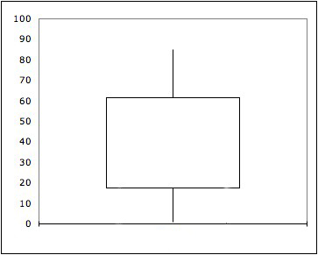
And here you go…

